Slide 1

Eng/ Mahmoud Hammam
Logic Functions using neural Networks
Section 2

Slide 2
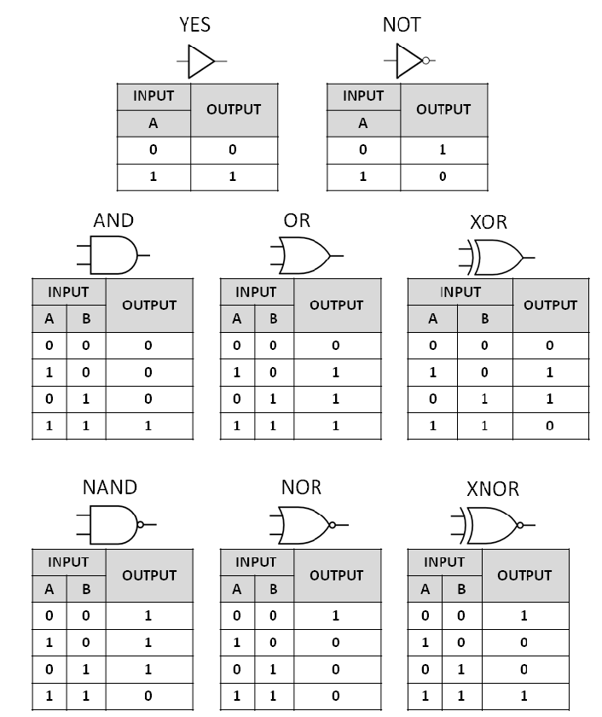
Neural Networks problem (Logic Functions)

Slide 3
Simulation for And Function
Threshold(2)= 2
X1
W = 1
Y
X2
W = 1

Slide 4

Simulation for OR
Threshold(Y) = 2
X1
W = 2
Y
X2
W = 2

Slide 5
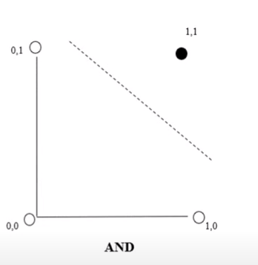
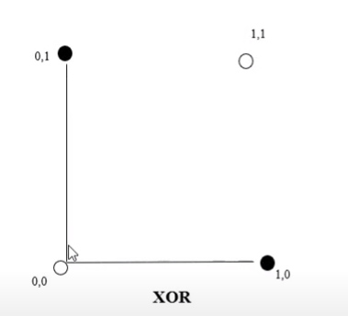
What is the meaning of Linearly separable

Slide 6
How to train a perceptron
-1
W = 0.1
X
W = 0.4
Y
W = 0.2
X(0) | X(1) | X(2) | SUMMITION | OUTPUT
-1 | 0 | 0 | (-1 * 0.1) + (0 * 0.4) + (0 * 0.2) = -0.1 | 0
-1 | 1 | 0 | (-1 * 0.1) + (1 * 0.4) + (0 * 0.2) = 0.3 | 1
-1 | 1 | 1 | (-1 * 0.1) + (1 * 0.4) + (1 * 0.2) = 0.5 | 1

